Slide 1
JUDGMENT ON THE BUS GOES ROUND AND ROUND:
Examining mental health stigma and the fundamental attribution error
Teresa Hulsey, B.A., Melissa L. Connally M.S., Danielle N. Moyer M.S.,& Amy R. Murrell, Ph.D.
Notes:
My name is Teresa and I’m a graduate student at the University of North Texas working with Dr. Amy Murrell, and the title of this presentation is:
[I am thankful to be presenting on this topic today, as it continues to have relevance.]
I would like to begin by asking you to participate in a short exercise.

Slide 2
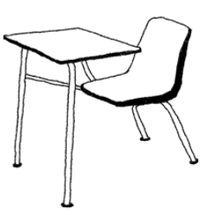
A student walks into your 50-minute class, 30 minutes late, on exam day.
Notes:
Imagine for a moment that a student walks into your 50-minute class, 30 minutes late, on exam day. Think about how you feel about this person. Do you like this person? Do you think the situation is the person’s fault? Is anyone willing to share their thoughts? (Be very careful not to accidently assign gender to the situation)

Slide 3
Notes:
Ok, now imagine that you get to read a tweet by this person. How do you feel now? And now? And now? And now? (allowing people if they are willing to give their thoughts)
Each tweet brought its own pieces of information

Slide 4
CONTEXT
Notes:
Context is the set of circumstances or facts that surround an event, and in terms of which it can be fully understood and assessed.

Slide 5
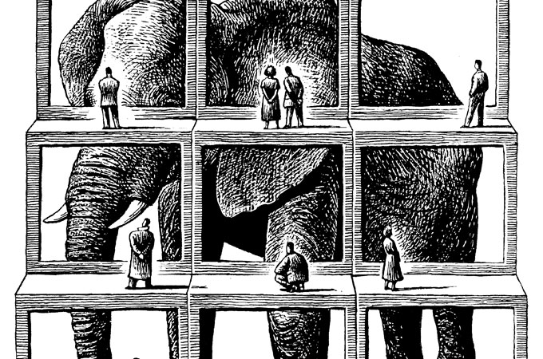
Context
Gaining more information about the behavior apart from the context (e.g., did the student walk in quietly, or begin throwing papers around?) will not make more sense of the behavior
Behavior not separate from context (Hayes, Holmes, & Wilson, 2012)
Notes:
Many times we don’t know or have access to the context. In an effort to make sense of what we are observing, we sometimes make what is called the fundamental attribution error.

Slide 6
FUNDAMENTAL ATTRIBUTION ERROR
Notes:
Fundamental attribution error
The FAE is the tendency to assign dispositional, or internal, characteristics as causes of observed behavior despite apparent contextual influences (Ross, Greene, & House, 1977). Situational factors that might be attributed to a behavior are either ignored or deemphasized (O’Sullivan, 2003).

Slide 7
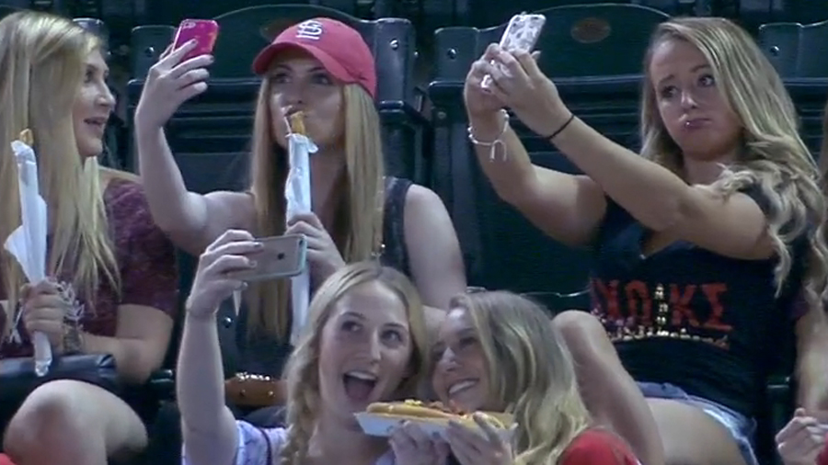
Fundamental Attribution Error
Notes:
Fundamental attribution error
[You may recall the story of the female fans that were publically shamed as vain and shallow. The situational factors were actually that they were prompted to take pictures, the majority are on academic scholarships, and they donated the tickets they received as an apology to a domestic violence non-profit.]

Slide 8
Psychological Flexibility
The ability to contact the present moment more fully as a conscious human being, and to change or persist in behavior when doing so serves valued ends (contextualscience.org).
Dynamic processes unfolding over time
How a person shifts perspective (Kashdan & Rottenberg, 2010)
Psychological inflexibility is significantly positively correlated with psychological distress (Bardeen & Fergus, 2016; Feldner, Zvolensky, Eifert, & Spira, 2003)
Notes:
One way in which we know can impact an individual's ability to consider those contextual factors is psychological flexibility. This could look like shifting one’s perspective.

Slide 9
MENTAL HEALTH
Notes:
Approximately 1 in 5 adults experience mental health difficulties in the United States (Substance Abuse and Mental Health Services Administration, 2014). There is evidence that mental illness is stigmatized by the general public (Corrigan, 2004).

Slide 10
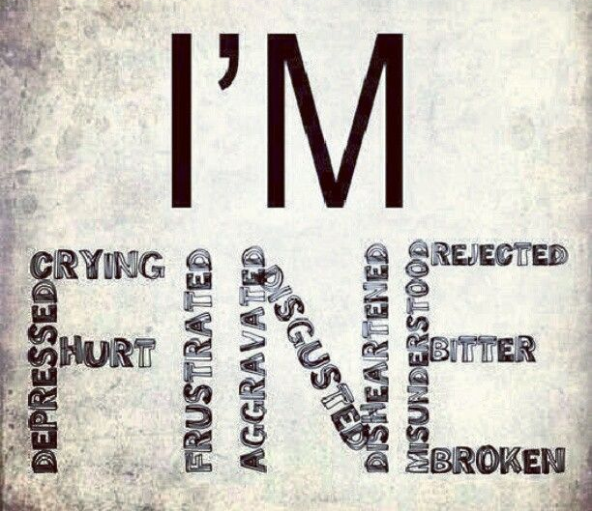
Mental Health Stigma
Notes:
Stigma is defined as a mark of shame associated with a specific condition or characteristic (Goffman, 1963).
Mental health stigma remains one of the most frequently identified barriers to seeking treatment (Corrigan, 2004).

Slide 11
The Original Study
Aimed to understand the extent to which contextual variables impact the FAE by exploring the shifts associated with varying degrees of contextual information
It was hypothesized that given more contextual information, participants would decrease the association of dispositional causes of one’s behavior and increase awareness of potential situational causes.
Participants were given 5 vignettes on a variety of social situations, then answered a series of questions based on factors of the FAE.

Slide 12
The Present Study
A total of 640 (452 females, 184 males) undergraduate students were recruited through an online psychology department participant pool at a large state university
Notes:
I am looking at one vignette in particular….expected stigma to decrease over time with increasing contextual information.
Twitter = ecologically valid method

Slide 13
The person you are sitting next to on the bus ride home begins to sob uncontrollably.

Slide 14
Notes:
The tweets

Slide 15
Measure | Sample Item | Alpha
Avoidance and Fusion Questionnaire-Youth (17 items; AFQ-Y; Greco, Murrell, & Coyne, 2005) | “The bad things I think about myself must be true.” | α = .92 (Schmalz & Murrell, 2010)
Depression Anxiety Stress Scales (21 Items; DASS-21; Lovibond & Lovibond, 1995) | “I was unable to become enthusiastic about anything.” | α = .88 (Lovibond & Lovibond, 1995)
Stigma (modified items from Attribution Questionnaire; AQ; Corrigan, Markowitz, Watson, Rowan, & Kubiak 2003)
I like this person. I think the situation is the person in the story’s fault. I would avoid this person.

Slide 16
Stigma will decrease over time as increasing contextual information is provided.
Linear Trend: Partial Eta Squared = .18, F(1) = 139.33, p < .001
Quadratic Trend: Partial Eta Squared = .01, F(1) = 8.28, p = .004
Cubic Trend: Partial Eta Squared = .24, F(1) = 197.96, p < .001
Notes:
ADD GRAPH

Slide 17
Stigma will decrease over time as increasing contextual information is provided, particularly for participants with a history of mental health treatment.
Linear Trend: Partial Eta Squared = .00, F(1) = .349, p = .555
Quadratic Trend: Partial Eta Squared = .00, F(1) = .817, p = .366
Cubic Trend: Partial Eta Squared = .00, F(1) = .087, p = .768
Notes:
ADD GRAPH

Slide 18
Stigma will decrease over time as increasing contextual information is provided, particularly for participants high in initial psychological flexibility.
Linear Trend: Partial Eta Squared = .00, F(1) = 1.73, p = .179
Quadratic Trend: Partial Eta Squared = .00, F(1) = 0.29, p = .751
Cubic Trend: Partial Eta Squared = .00, F(1) = 0.61, p = .541
Notes:
ADD GRAPH
- They are

Slide 19
Stigma will decrease over time as increasing contextual information is provided, particularly for participants with lower levels of initial psychological distress.
Linear Trend: Partial Eta Squared = .00, F(1) = 0.55, p = .580
Quadratic Trend: Partial Eta Squared = .00, F(1) = 1.06, p = .348
Cubic Trend: Partial Eta Squared = .00, F(1) = 0.82, p = .442
Notes:
ADD GRAPH
- Situational is more influential with increasing context than the dispositional traits for this scenario – looking across measures

Slide 20
Discussion & Clinical Implications
Notes:
-The results normalize the human capacity to judge – even when the subject is unknown and the data is limited.
[However, we humans function in a social-verbal community that reinforces our understanding of the conditions around us; meaning that we have to infer motives from what we can see (Andrews, 2011).
-The study supports existing research that increasing contextual information can reduce the FAE.
-Further, the study may provide support in combating and preventing mental health stigma.
-Increasing psychological flexibility may also be a important factor in facilitating perspective taking, openness, and understanding.
-The findings may also provide important information regarding the current psychological states of individuals, as it relates to stigma of mental health issues.
Ethan will cover limitations
This particular vignette, features an individual crying on the bus. The gender of the individual is purposely not presented. As such, the impact of social expectations regarding gender and the expression of emotion is unexplored.
The research methodology using a twitter feed may evoke initial biases and reactions. Although this was accounted for through use of a question, future research may benefit from exploring this effect using a different modality.
Locus of control – sample of college students, general trend makes sense given participants are college students (e.g., missing bus (internal) and teacher moving test date up (external)

Slide 21
Thank you!
Teresa Hulsey
University of North Texas
teresahulsey@my.unt.edu
Notes:
Special thanks to Taylor Lincoln

